Slide 1
A* Algorithm
PriorityQueue ordering is based on
f(n) = g(n) + h(n)
where g(n) is the cost or distance from start to vertex and
h(n) is the heuristic estimated cost from vertex n to goal vertex

Slide 2
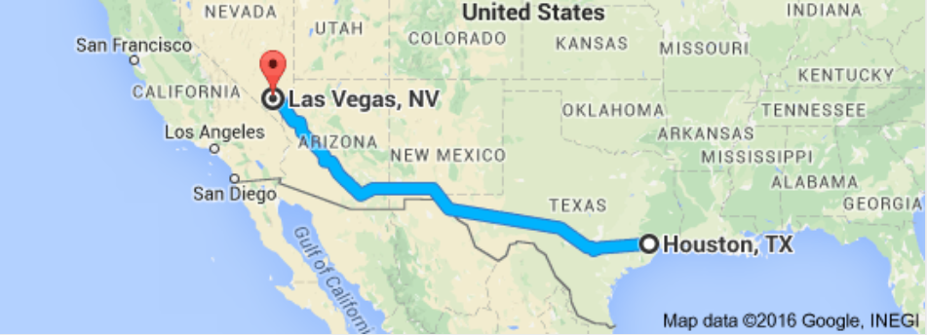
A* Algorithm

